Slide 1



Slide 2


WebXR Demo Code Development
(5 mins.)
Wei Chung Chuo
Lead Developer Technical Engineering Solution
Futurewei Technologies, Inc.
Notes:
Note: This is a 5 minutes code demo presentation.

Slide 3
Agenda
About Wonderland Engine and main features
Download and install Wonderland Engine, Visual Studio Code, Wolvic
Wonderland Engine overview
Getting started: create a new VR project
Import and modify objects
Apply Javascript components to objects
Modify scene view
Apply Javascript logic to the scene
View and debug in Huawei VR Glass
Demo codes, download and websites
Notes:
Hello everyone! My name is Wei Chung from Futurewei Technologies. Today we’re going to go over what the Wonderland Engine is, its main features, and an introduction to how to build your own VR experience using the Wonderland Engine. From this video, you will learn:
How to set up your development environment.
The different parts of the Wonderland Editor UI
Getting started with a new VR project and adding in objects
Applying JavaScript components to your objects
Modify the scene view, apply Javacript logic to the scene
And lastly, how to debug a game from the Huawei VR glass

Slide 4

About
Wonderland Engine is a development platform for web-based graphics applications. It comes with an accessible 3D editor application – the Wonderland Editor – and an efficient WebAssembly-based runtime that runs in the browser.
Wonderland Engine enables you to easily build highly performant graphics applications for the web.
Notes:
The Wonderland Engine is a development platform for web-based graphics applications, specifically for VR and AR.
It comes with an accessible 3D editor application, the Wonderland Editor, and an efficient WebAssembly runtime that runs in the browser.
The Wonderland Engine enables you to easily build highly performant VR and AR applications for the web.

Slide 5
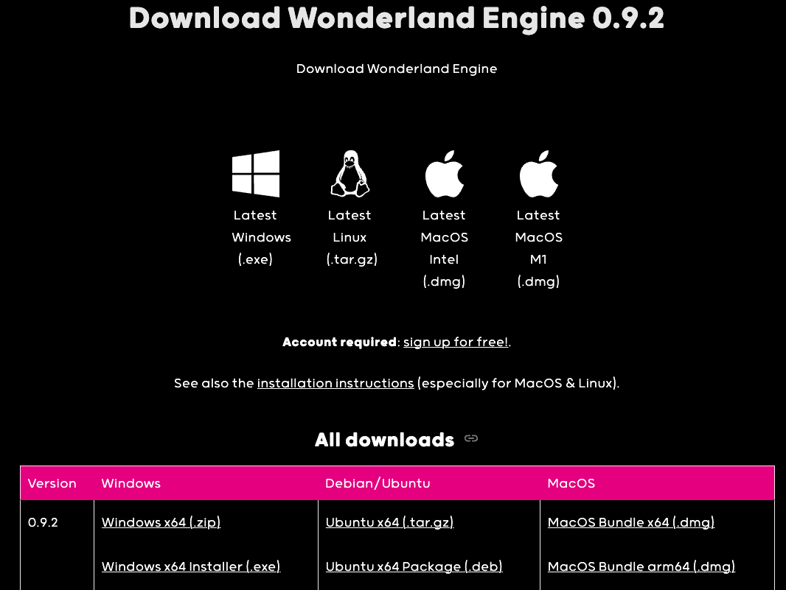

Download and install
Create an account - https://wonderlandengine.com/account/
Download Wonderland Engine from the website - https://wonderlandengine.com/downloads/
Notes:
Before we can begin creating a new Wonderland project, please use the QR code or URL to create an account, download and install Wonderland Engine.

Slide 6
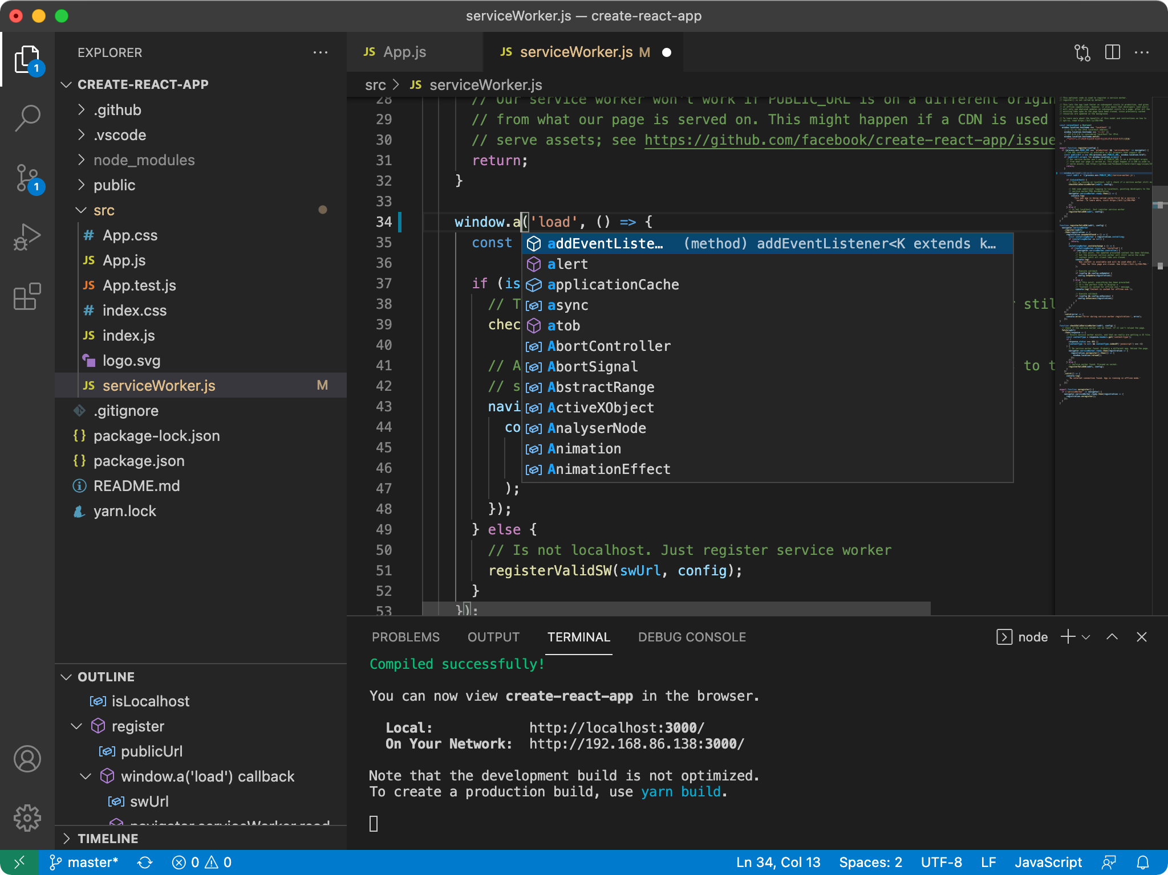

Install a code editor – Visual Studio Code
Wonderland Editor cannot edit JavaScript files. An external code editor is required. Visual Studio Code is recommended.
Download Visual Studio Code from the website - https://code.visualstudio.com/
Notes:
The Wonderland Editor is only for making changes to the 3D environment. A separate code editor is needed to edit the JavaScript files, and we recommend using Visual Studio Code for this, you can follow the QRCode or URL to download it.

Slide 7
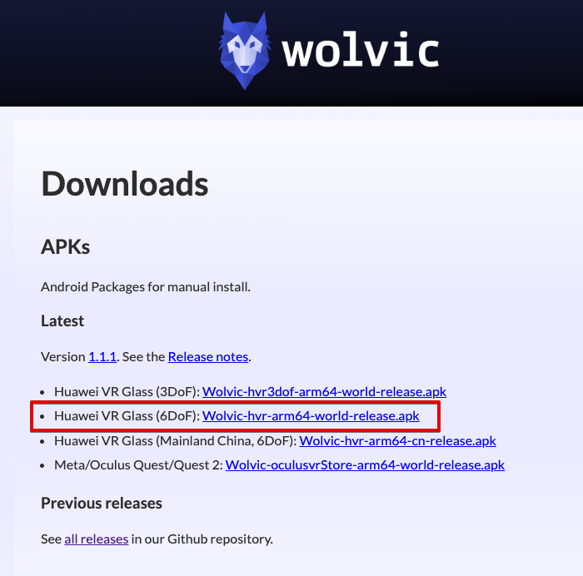

Install Huawei VR Glass Browser – Wolvic
Download and install Wolvic VR Browser 6DoF (Wolvic-hvr-arm64-world-release.apk) - https://wolvic.com/dl
Notes:
In addition to a code editor, you’re going to need a full VR Browser app to run the game on your Huawei phone. The Wolvic VR Browser is the only VR-capable browser created for the Huawei VR Glass. Please download Wolvic VR Browser 6DoF version from wolvic.com/dl.
Before moving onto the next step, let me introduce you to Bryant, and he will explain the code development.

Slide 8
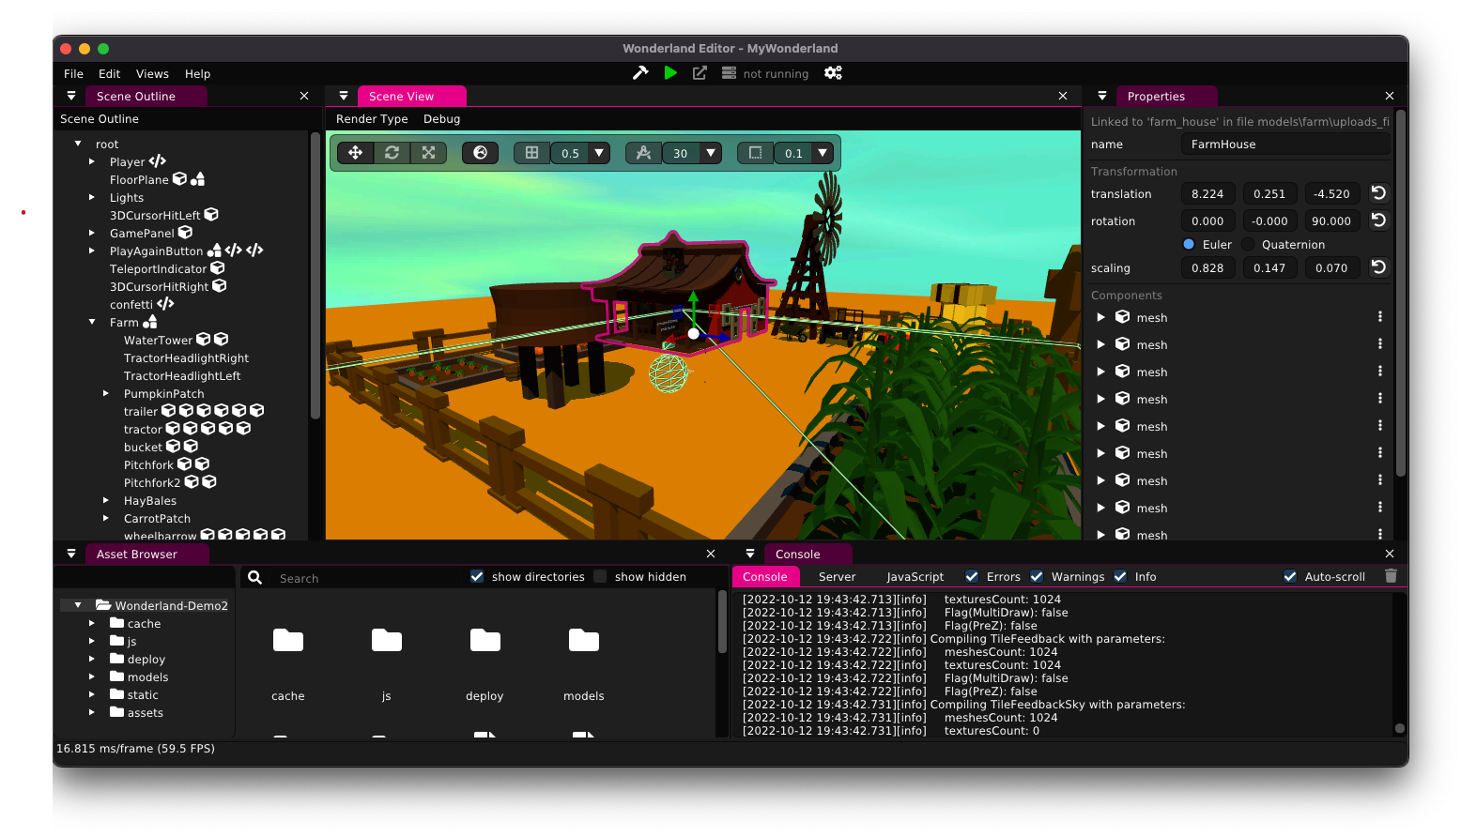
Wonderland Engine overview
Package the entire project into deployable files
Package, start server, open browser
Open Browser
Start/stop server
Scene Outline
View, manage the scene, object hierarchy, etc.
Properties
Scene View
Console, Server, Javascript panel
View the logs here for debugging
Asset Browser
Drag-n-drop assets into Scene
Notes:
Hello everyone, I’m Bryant from Futurewei Technologies.
Here’s what the layout of the Wonderland Editor looks like, which is similar to a streamlined 3D model editor.
The Scene View displays a preview of the 3D environment
All objects can be viewed and managed from the Scene Outline.
The Asset Browser allows for drag-and-drop importation of assets into the project.
Individual object properties can be changed from the Properties View.
The console can be viewed from the bottom right for debugging.
You can package and start your game server from the top center of the window.

Slide 9
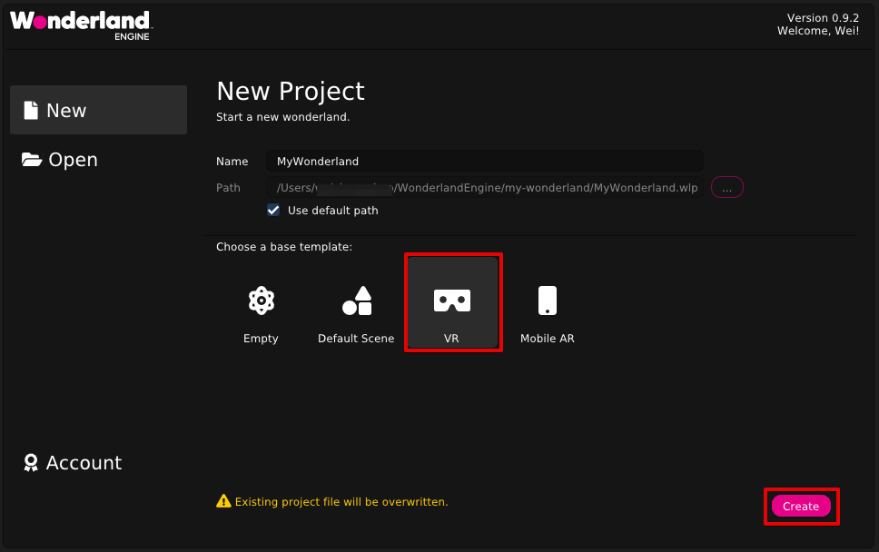
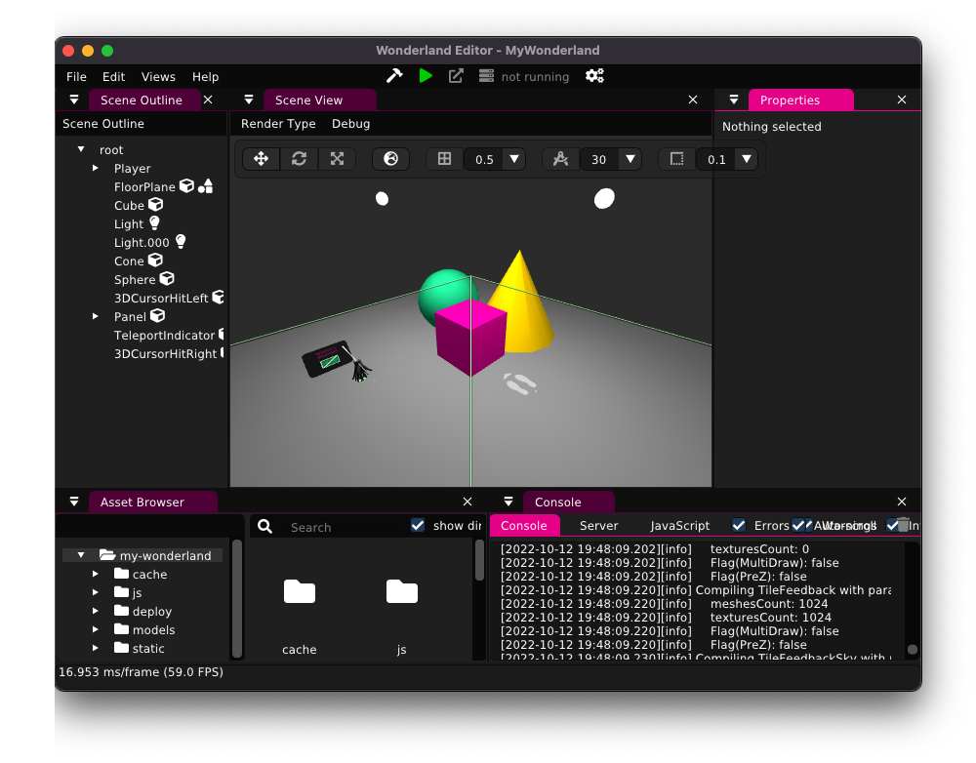
Getting started - create a new VR project
Create a New Project with VR template.
Notes:
Now that we’ve got all the tools installed and our environment setup, let’s create a new Wonderland project.
From the welcome screen select New > VR template > create to open up a new project.

Slide 10
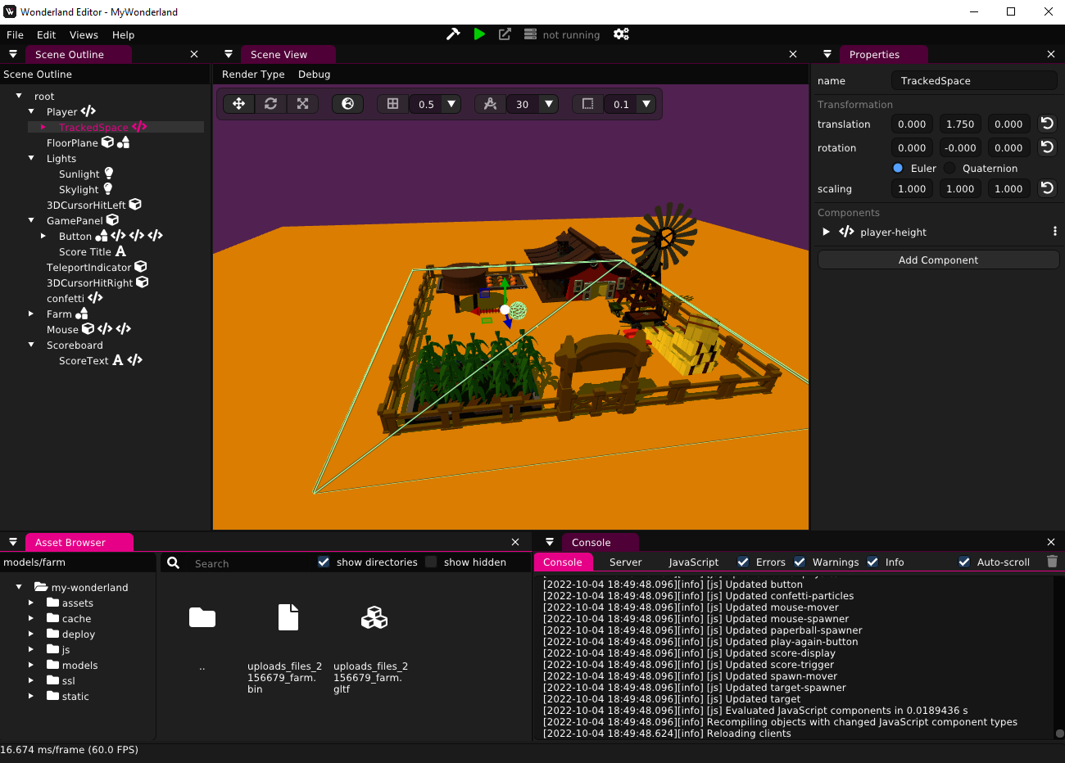
Import 3D objects into the scene
#4
From the Asset Browser, open the models folder.
Drag and drop your 3D objects from your system into the models folder.
Drag and drop your 3D objects from the models folder into the Scene View.
Your object should show up in the Scene View as well as the Scene Outline.
#3
#1
#2
Notes:
We start the project off by importing all the 3D models needed. This can be done by first dragging and dropping the files directly into the models folder of the Asset Browser and then dropping them into the Scene View.

Slide 11
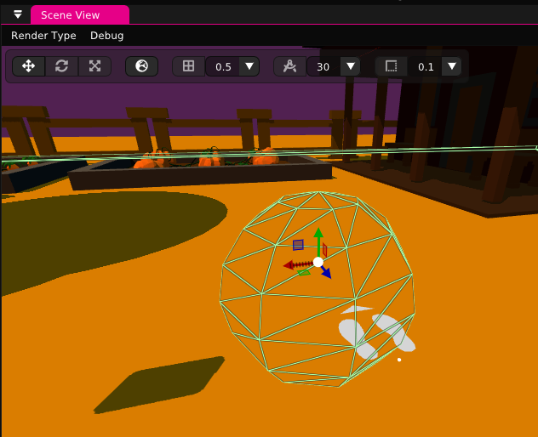
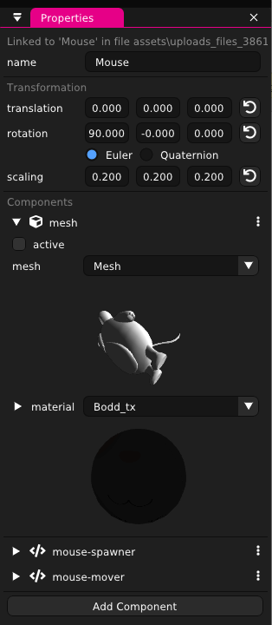
Modify objects
#1
#3
Objects can be modified directly in the Scene View - Translation, rotation, and scaling by dragging the mouse/trackpad.
Changes can also be made from the Properties view by inputting values for greater precision.
Component values can also be modified in the Properties view.
#2
#3
Notes:
Objects transformation can be done from either the Scene or Properties View. Modifications made from the Scene View are best for coarse changes while the Properties View allows for precision changes.
Additionally, the Properties View can be used to change JS component values.

Slide 12
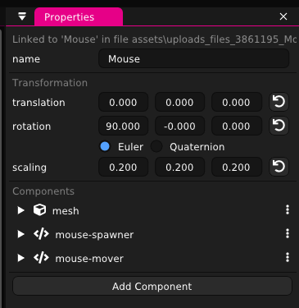
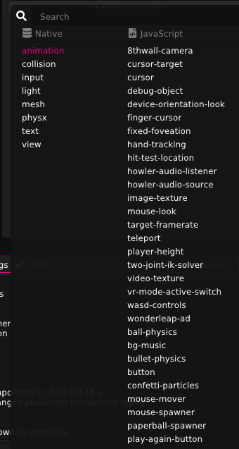
Adding JavaScript components to objects
JS components can be added to each object from the Properties view.
Some of these components come with Wonderland (ex: 8thwall-camera, howler-audio-source) and the rest are user defined (ex: mouse-mover, mouse-spawner).
Notes:
The Properties View not only allows for changing the values for JS components, but components can also be added to objects from this view as well.

Slide 13
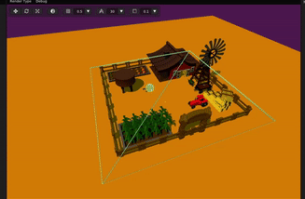
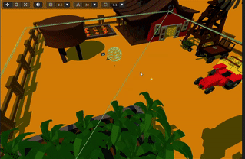
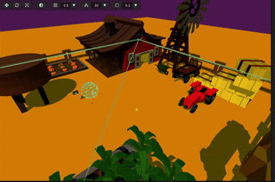
Modify scene view
Zoom using the scroll wheel
Pan by right-clicking and dragging
Rotate by holding the middle-mouse button and dragging.
#1. Zoom
#2. Pan
#3. Rotate
Notes:
To change the camera view of the scene, we can zoom using the scroll wheel, pan by right-clicking and dragging, or rotate by holding the middle-mouse button and dragging.

Slide 14
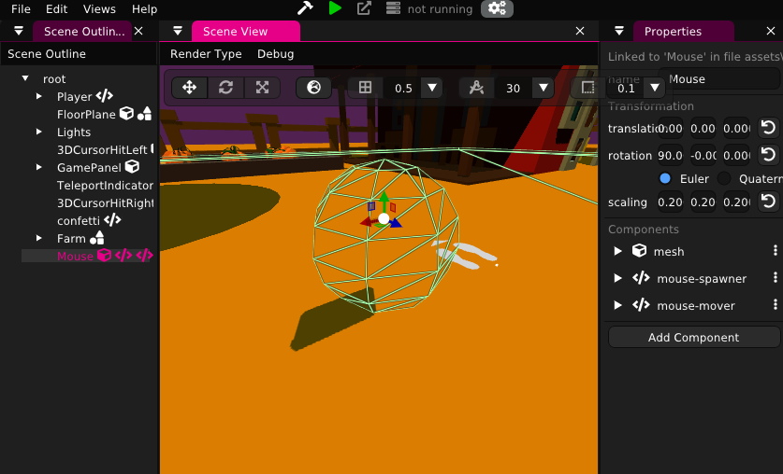
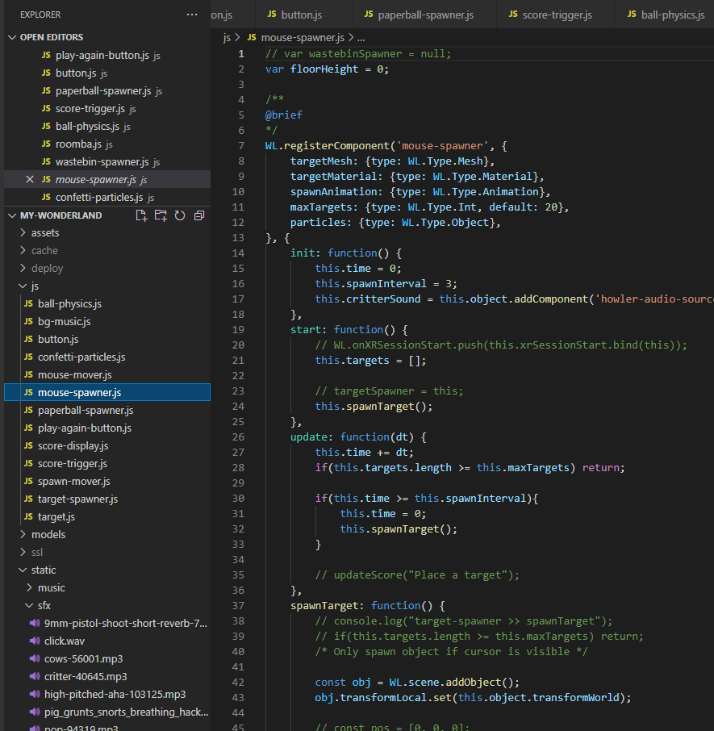
Apply Javascript logic to the scene
Use code editor like Visual Studio Code to add Javascript components and define the behavior of individual objects, such as movement, object spawning, adding/removing components, collision effects, etc.
Notes:
To apply JavaScript to our Wonderland project, we need to use a separate code editor like Visual Studio Code to make the actual code changes. The JavaScript defines the behavior of individual objects, such as movement, object spawning, adding or removing components, collision effects, etc.
With that, we have covered the basics of code development.

Slide 15
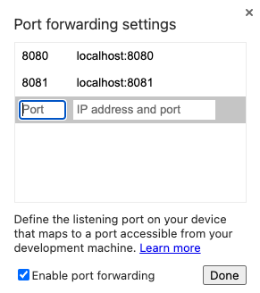
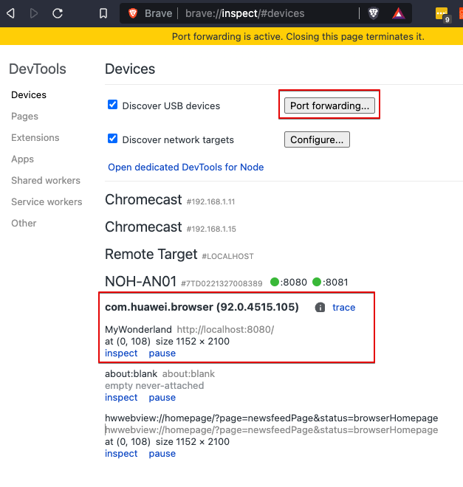
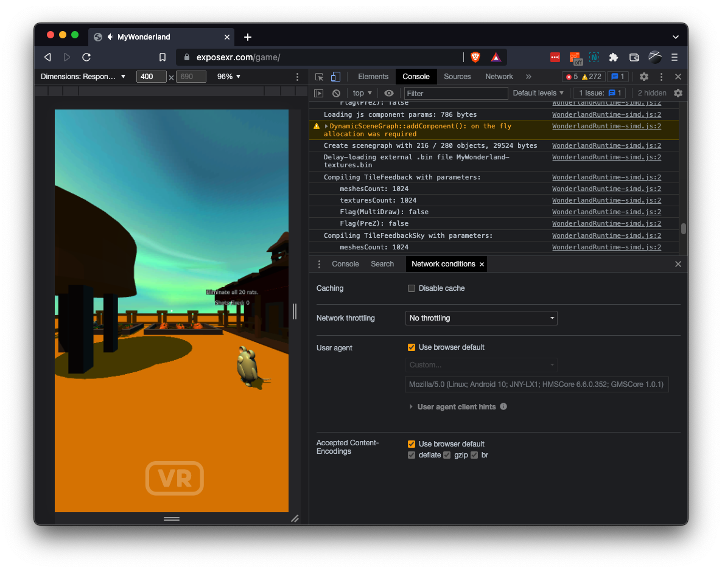
View and debug in Huawei VR Glass
Enable USB debugging on Huawei VR compatible Huawei phone.
Enable ADB over Wi-Fi and connect to Huawei phone.
Generate SSL key, certificate, and DH parameter files.
Wonderland Engine - navigate to Views > Preferences > Server, enable SSL server and enter the SSL files.
Repackage Wonderland project and launch the server.
Go to desktop Chrome browser, enter URL chrome://inspect#devices, click Port Forwarding button, add Port: 8081, IP address and port: localhost:8081. Check Enable port forwarding and click Done.
Put on Huawei VR Glass, launch either the Wolvic VR Browser and visit https://localhost:8081/index.html
Notes:
Thanks Bryant!
When using the Huawei VR Glass, it is not possible to connect the phone via USB and debug the Wonderland game while it’s running on the device. This is because there is no available USB port on the phone, as it is taken up by the VR Glass.
Instead, we have to use ADB over Wi-Fi to connect to the Huawei phone. This can be done by enabling ADB over Wi-Fi on the Huawei phone, configuring the SSL server on the Wonderland Editor, and using localhost port 8081 instead of localhost port 8080 to connect to the Wonderland local server. You can follow the guide to set up your development environment.

Slide 16
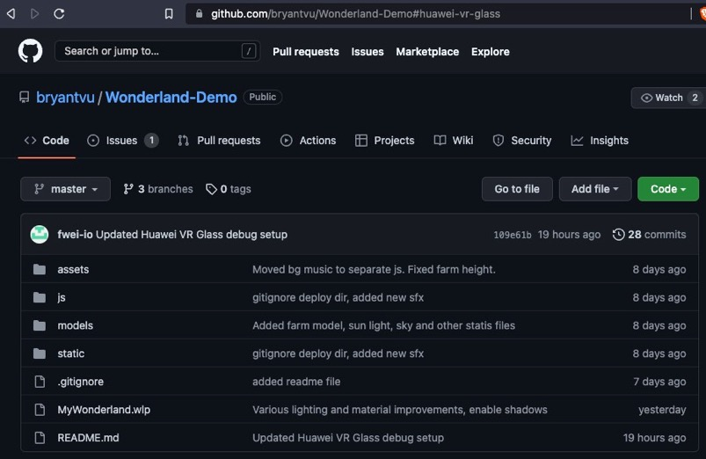

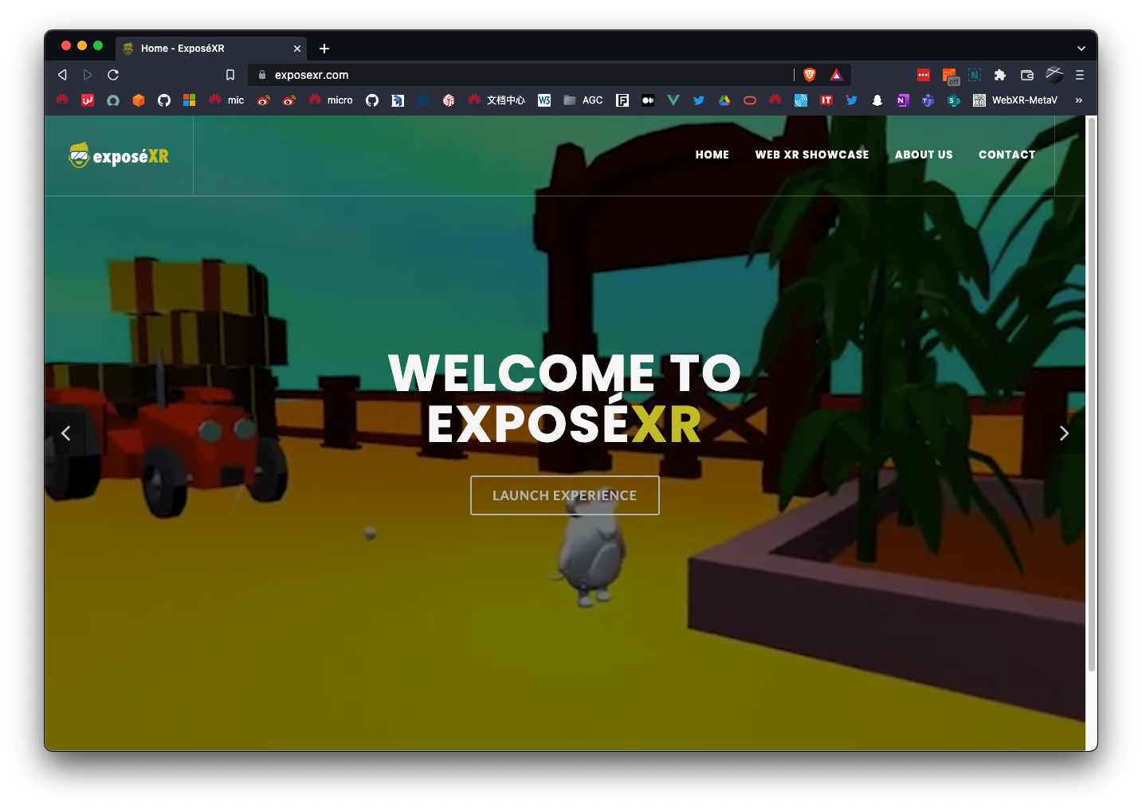


Demo code, download & websites
https://github.com/hms-ecosystem/Wonderland-Demo
https://wonderlandengine.com/downloads/
https://wolvic.com/dl
https://exposexr.com/zh
Notes:
That concludes our presentation on the Wonderland Engine demo. Here are the links for the free and complete game source code, the Wonderland Engine itself, the Wolvic VR Browser, and the our website running a live instance of the game. Thank you!

Slide 17
Thank You
Wei Chung Chuo
Lead Developer Technical Engineering Solution
Futurewei Technologies, Inc.
For Further Information:
http://HDC.com (based upon final website link)

